Slide 1


2019
Department
Of Computer
Science
&
Electrical And
Electronics
Engineering
MATH-IV
KAS -402
2020-2021
Dr.Rupa Sharma
Associate Professor
vsrsrsys@gmail.com

Slide 2
Topic-9 [find the particular integral] Case -3

Slide 3



EX:

Slide 4
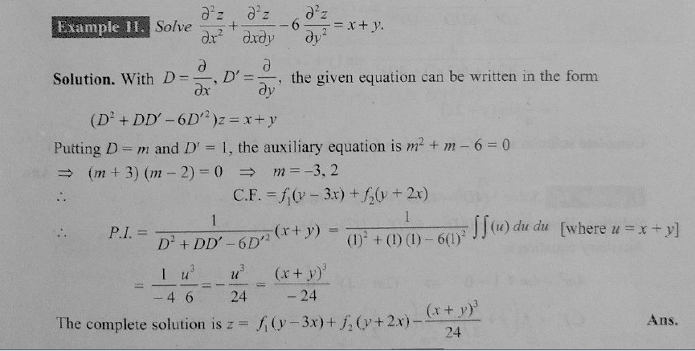

Slide 5
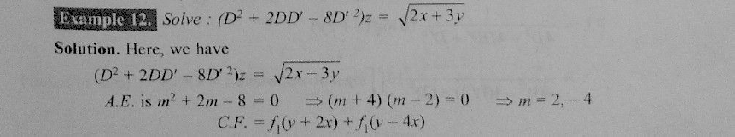
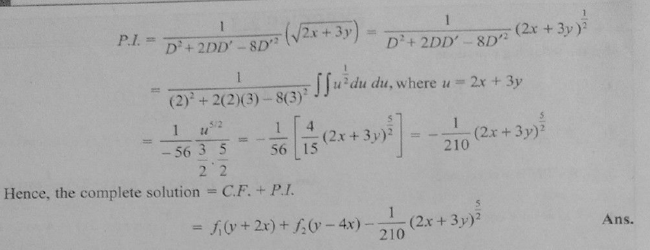

Slide 6


HOME Work
ANS:
ANS:

Slide 7
THANK YOU

